Slide 1
Construction Clients’ Group Auckland
30 July 2020
Notes:
Tuan to open

Slide 2
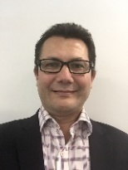
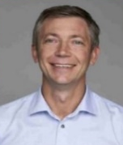
Presenters
Tuan Hawke – Programme First Solutions and Implementation Lead (Watercare)
Matthew Findlay – Programme First Contractor Representative (Fletcher Construction)
Ian Jonkers – Programme First Contractor Representative (Fulton Hogan)
Ryan Jones – Programme First Construction Supply Specialist (Fulton Hogan)
Notes:
Tuan

Slide 3
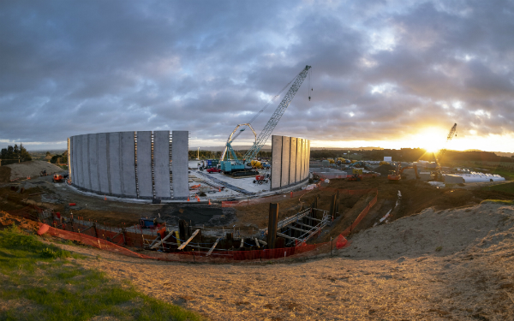
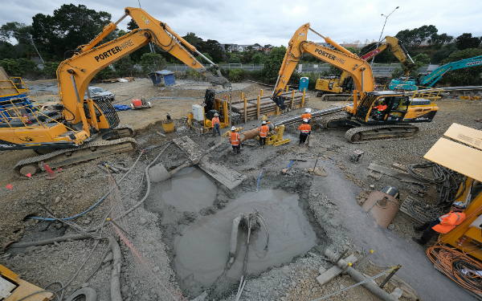
Watercare Fast Facts
Notes:
Tuan

Slide 4
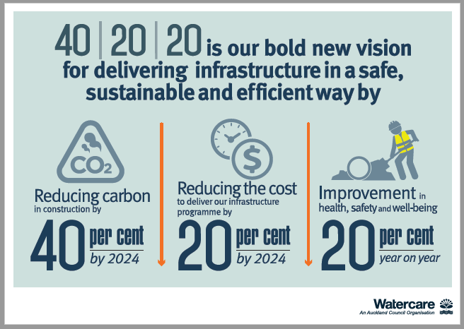
40:20:20 Vision
Notes:
Tuan

Slide 5
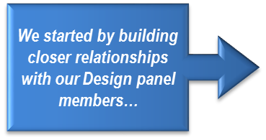
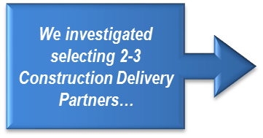
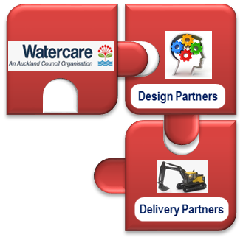
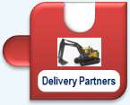
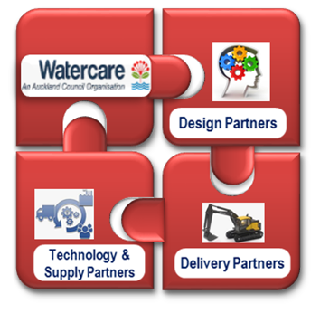
Enterprise Programme Delivery
A Progression In Our Thinking
Enterprise Model
Notes:
Tuan Strategy overview.

Slide 6
Enterprise Model
Notes:
Tuan

Slide 7
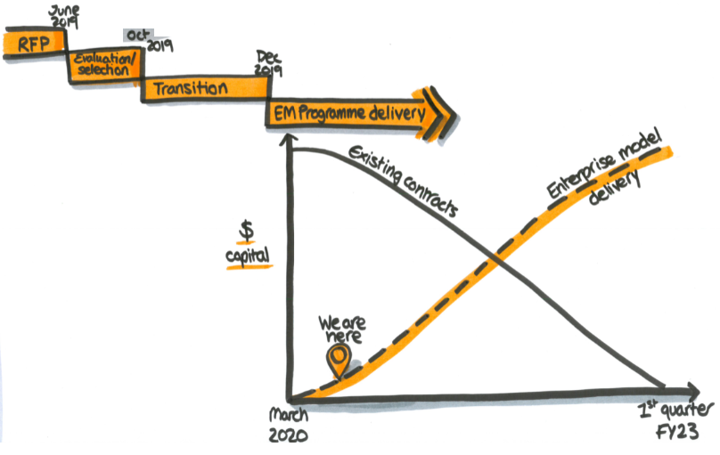
Enterprise Model status
'Development' to 'Doing’
Partnership and collaboration
Realising value
Notes:
Matt

Slide 8
EM Principles at work
Protective - Risk avoidance benefits
Get the basics right
Productive - Continuous Improvement benefits
Delivering value for money
Progressive - Game-changing benefits
Enable growth and game changing opportunities
Notes:
Matt

Slide 9
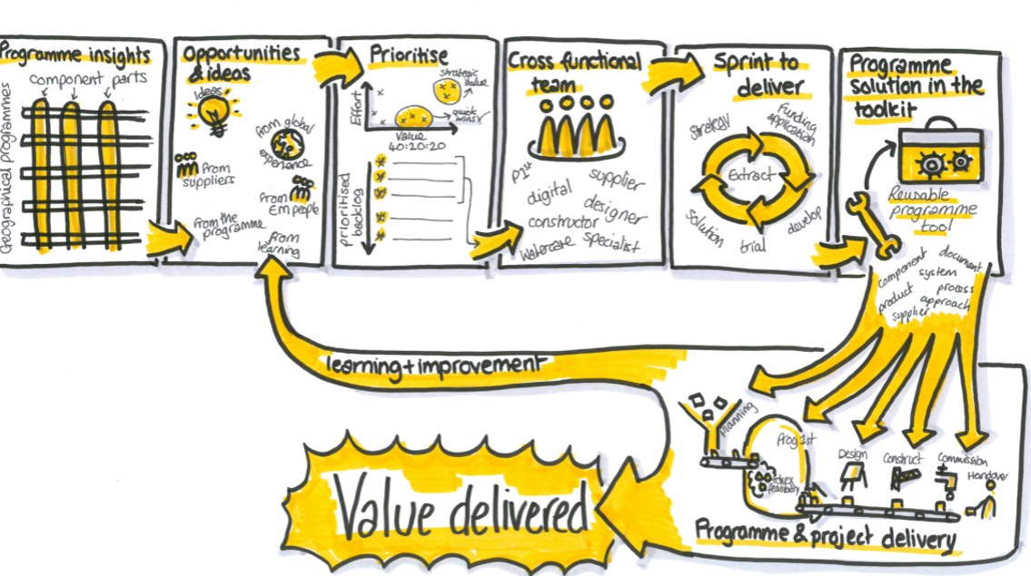
Innovation and continuous improvement process
Gate 1
Idea accepted
Gate 3
Initiative plan approved to go ahead ($)
Programme first own and govern this process
Gate 2
Idea prioritized
Your ideas!
Gate 4
Complete and rolled out
An overview of this process is available on Immerse
(Watercare’s learning management system)
Teams
implement!
Notes:
Matt

Slide 10
Toolkit
The Toolkit is made of reusable programme tools, these could include:
Supplier agreements
Digital tools/systems
Standard Products
Design library
Material and equipment Standards
Processes to apply to project delivery or the project management framework
Ways of working
Approaches and methodologies
Training programmes and material
Coming soon;
smart online toolkit
Currently distributed via email or available on Watercare intranet;
DOCS BOX/Infrastructure/
Enterprise Model
Notes:
Ian

Slide 11
Tools – available now/soon
Safety alerts
Collaboration workshops
Predictive index
Logistics hubs
Leadership walks
Combining safety alerts
Set agendas for feasibility and design
Design library
Available now
Available now with ongoing trials
Available now
Team debriefs available soon
In development
Principles agreed
First site identified – Southern hub opportunity
Available now
Visible leadership onsite
Designs in one place
Carbon portal
EM Mindset
Available now
Nominations process
Self development to come
Available now in trial
Wider roll out planned August
Notes:
Ian
Tools ready to go (and over next few months)
Protective – getting the foundations right

Slide 12
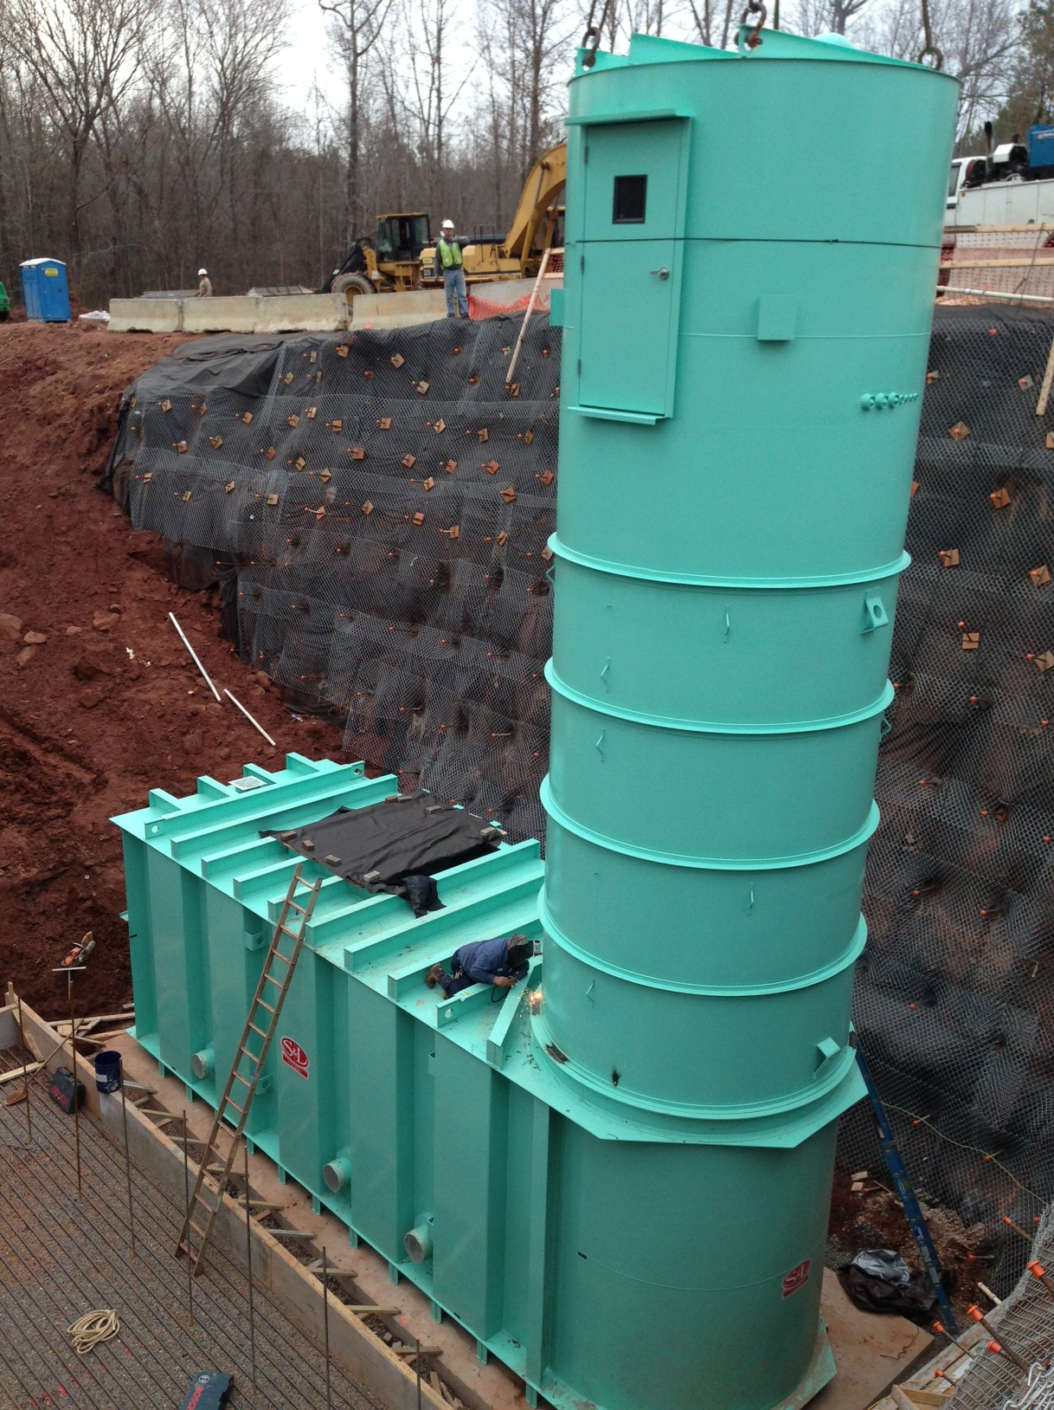
Toolkit Opportunities - Product Based Design & Pre-fabrication
* Example: Smith & Loveless Inc Package Pump Station.
Notes:
Ian

Slide 13
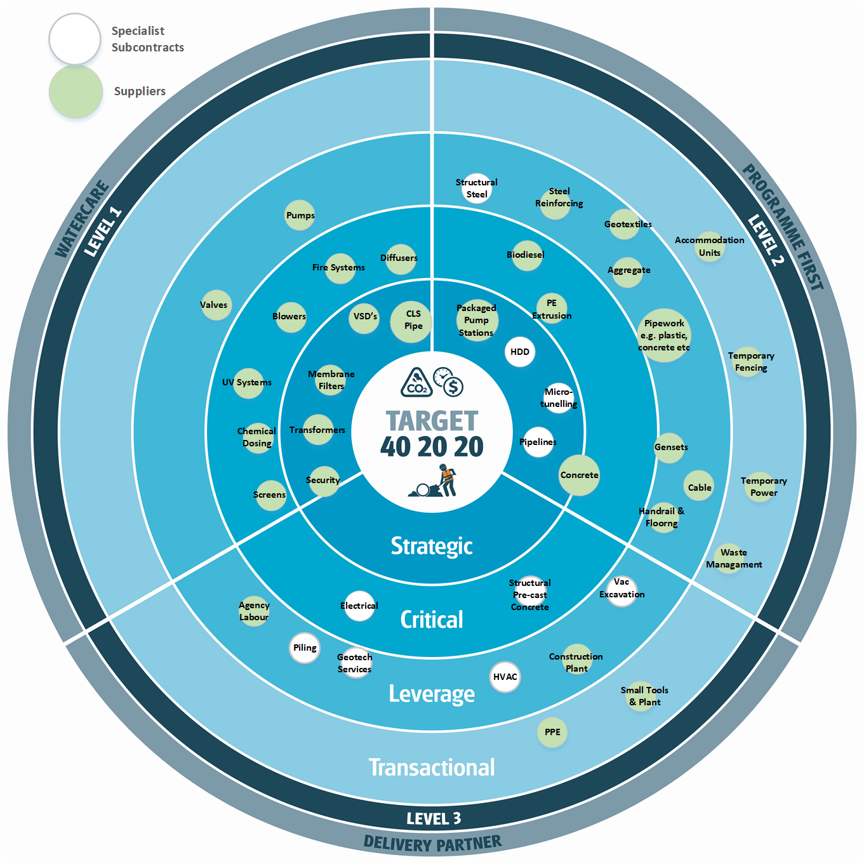
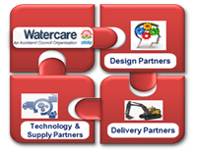
Supply Chain Ecosystem
Notes:
Ryan
Supply chain outreach and mobilizing
This model illustrates the approaches to be take with the supply chain.
Towards the centre, the more critical and strategic categories of supply will require a particular approach which may include partnering under a more collaborative approach either managed by Watercare, P1st or the Delivery Contractors. These categories will have more of an impact on our 40:20:20 target.
The categories towards the outer rings are such that they will be approached in a more traditional manner.

Slide 14
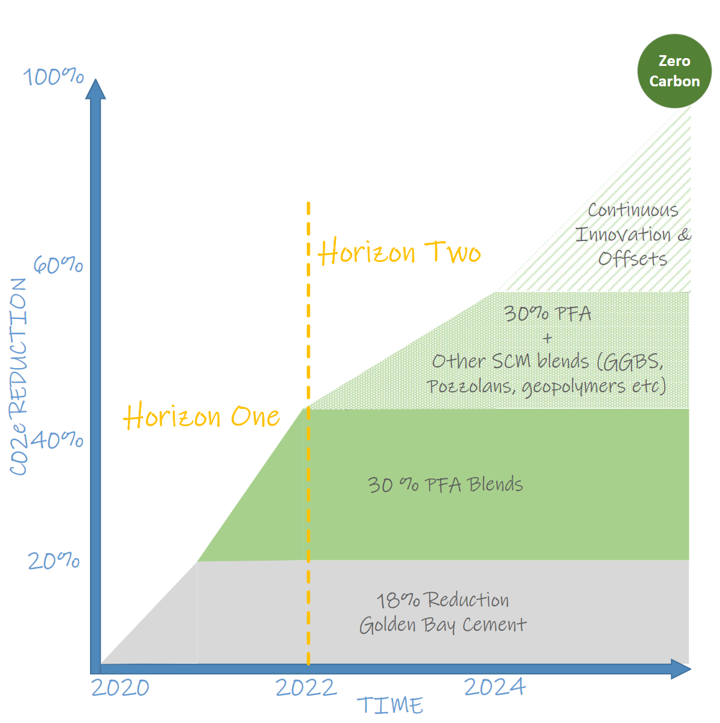
Supply Chain Opportunities - Concrete (journey to zero carbon)

Slide 15
40:20:20 - Key Initiative Journey
Product Based Design
Pump Stations Design Library
Offsite Manufacture
Logistics Hubs Construction Hubs
Switchgear
Trenchless Construction
Network resilience / operational requirements
Rehabilitation and repurposing technology
HDD + Tunnelling Specialist partners vs self-perform
Construction and Design Excellence
Safety in Design / Safety in construction
Project management systems / site 360 record capture
3D design and construction
Construction rehearsals
Supply Chain
CLS Concrete
Specialist Subcontractors Partners
Aggregates + Supply Agreements
Well Being Health and Safety
Reporting and baselines
Standard Inductions, MiC
Critical Risk Management tools
Now Dec 2020
Notes:
Tuan

